Slide 1
Interesting cases presentation
Dr.Priyanka devi
JUNIOR RESIDENT

Slide 2

NAME :Mrs: A
AGE : 34 yrs
DOA : 23-4-2015
Diagnosis : G1 5 wks 5 days
at admission Cervical ectopic pregnancy

Slide 3

COMPLAINTS
Primi gravida referred as a case of cervical ectopic pregnancy at 5 wks 5 days of gestation with complaints of
- H/o lower abdominal pain and heaviness
10 days
- bleeding per vagina on
15-4-15 (soaked 4 pads)

Slide 4
CLINICAL PRESENTATION
O/E
GC fair, afebrile , PR-80/min,BP-100/60 mmHg
P/A – soft
P/S - Cervix and vagina are healthy
bleeding through os (+)
P/V – Uterus RV,NS ,mobile,os closed,cervix
3 cm long

Slide 5


USG
24-4 -15(TVS)
Single gestational sac
in cervix region
CRL-6+6 wks, CA (+)
B/L ovaries normal
Uterus and decidua-
normal
no free fluid
TAS-
Gestational sac seen in cervix below the level of internal os
Decidua in uterine cavity

Slide 6

23-4-15 TO 26-4-15
no complaints of abdominal pain
H/o ocassional spotting
Gc fair ,afeb, PR-86/min BP-110/70 mm Hg
P/A –Soft L/E-No bleeding
Inj methotrexate 70 mg im given
TVS (26-4-15)
Intracervical canal 0.66 cm ,
gestational sac[+], CA (+)
CRL -6+4wks,
yolk sac – 0.34 cm; ET -1.2 cm
27-4-15 29-4-15
β HCG – 11,610 mIU/ml 12,575mIU/ml

Slide 7
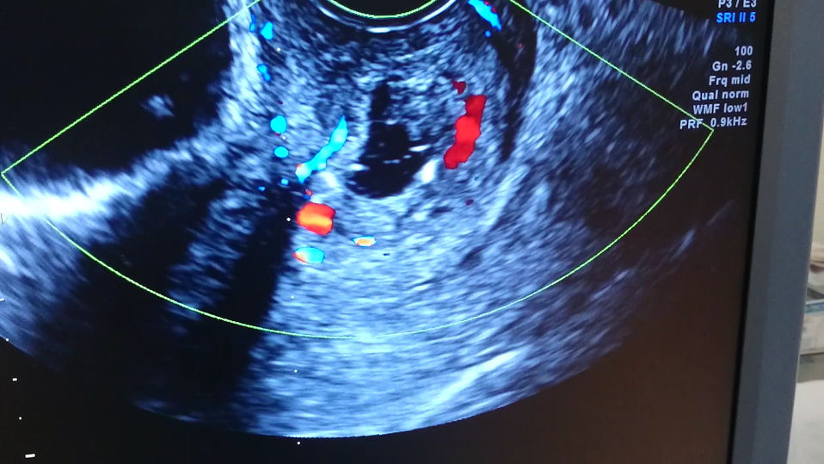

Slide 8
INTRA AMNIOTIC INSTILLATION OF METHOTRXATE AND
INTRA CARDIAC INJECTION OF KCl
Under aseptic precautions, under trans vaginal guidance
Intra amniotic instillation of methotrexate 50 mg done
Intra cardiac injection of 4 meq of Kcl given
Post procedure absence of cardiac activity confirmed
Patient withstood procedure well

Slide 9

Post procedure
Gc fair ,afebrile,no pallor.
PR – 80/min BP- 100/60 mmHg
P/A- soft
no bleeding P/V noted
6-5-2015
TVS
ET-1.5cm
No yolk sac ,No cardiac activity
gestational sac 0.7*0.7 cm irregular in transverse section
no free fluid in POD
asy
Patient got discharged at day 6 of the procedure

Slide 10
11-5-15 D10 0f the procedure
Patient presented with c/o bleeding p/v
o/e Gc fair ,afebrile,PR-90/min
BP -110/70 mmHg
P/A -soft ,no free fluid
L/E – superficial soakage SVP

Slide 11

12-5-15(USG)
Gestational sac in cervix -0.9*0.8CM
ET --10 mm
PATIENT GOT DISCHARGED ASYMPTOMATICALLY ON 13-5-15

Slide 12

Discussion
Cervical ectopic pregnancy constitutes
1 in 9000 pregnancies
It contributes 1% of ectopic pregnancies
Many a times it is misdiagnosed as threatened abortion
Hence, a high suspicion for cervical ectopic pregnancy is needed

Slide 13
DIAGNOSIS
HISTORY
CLINICAL
FEATURES
USG

Slide 14
History
Amenorrhoea followed by vaginal bleeding {mild,moderate,severe}
H/o abdominal pain
H/o giddiness

Slide 15
STABLE UNSTABLE
- pallor +/- - pallor +
- PR ,BP – Stable - tachycardia
-hypotension
-P/A-soft/tenderness -P/A-tendeness+
- guarding +
-rigidity +
-vaginal bleeding +/- - vaginal
bleeding+/-
HAEMODYNAMICS

Slide 16

Criteria for diagnosis
RUBIN ‘ S CRITERIA{1911}
Cervical glands must be opposite the placental attachment
Placental attachment to the cervix must be situated below the entry of uterine vessels or below the peritoneal reflection of anterior and posterior surface of uterus
Fetal elements must be absent from the corpus uteri

Slide 17

Clinical criteria
Palman and McElin:
Uterine bleeding without a cramping pain following a period of amenorrhoea
Soft,enlarged cervix equal to or large than the fundus{hourglass uterus}
Products of conception entirely and firmly attached to the endocervix
A closed internal os
A partially opened external os

Slide 18
USG
TVS
Empty uterus
Enlarged barrel –shaped cervix
Gestational sac within the cervical canal with or without cardiac activity
Peritrophoblastic blood flow and presence of cardiac activity in the cervical region
Absence of “sliding sign”

Slide 19
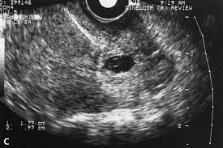

Slide 20
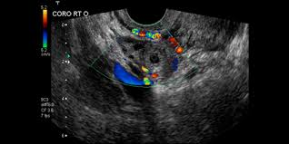

Slide 21
THANK YOU

